Slide 1

CAR PRICE PREDICTION
JYOTI TRIVEDI

Slide 2
OBJECTIVE
The price of new cars in the industry is fixed by the manufacturer with some additional costs incurred by the Government in the form of taxes. So, customers buying a new car can be assured of the money they invest to be worthy. But due to the increased price of new cars and the incapability of customers to buy new cars due to the lack of funds, used cars sales are on a global increase.
There is a need for a used car price prediction system to effectively determine the worthiness of the car using a variety of features. Even though there are websites that offers this service, their prediction method may not be the best.
Besides, different models and systems may contribute on predicting power for a used car’s actual market value. It is important to know their actual market value while both buying and selling.

Slide 3
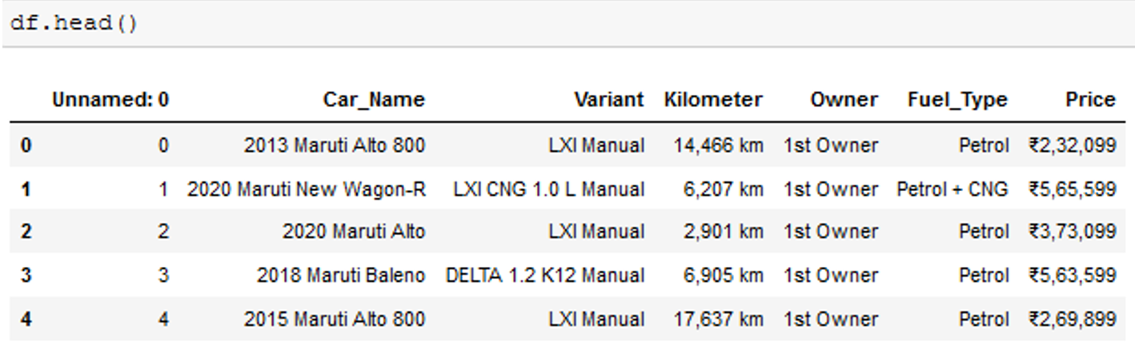
DATA
Historic data for prediction/classification of the problem
Past car prices for each route collected on daily basis
Python script was run on remote server which collected prices at specific times

Slide 4
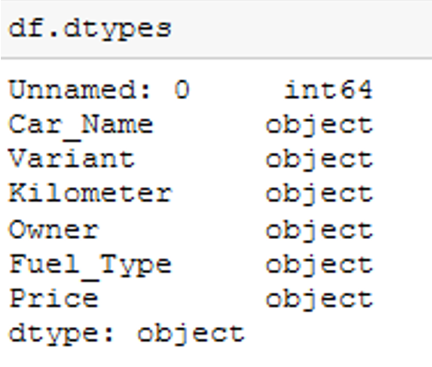
ATTRIBUTE TYPES
Data collection -> Data pre-processing
Below provides the information that the label, that is the variable that I want to predict, is continuous meaning I have a regression problem and not a classification problem that would be the case if label was discrete.

Slide 5
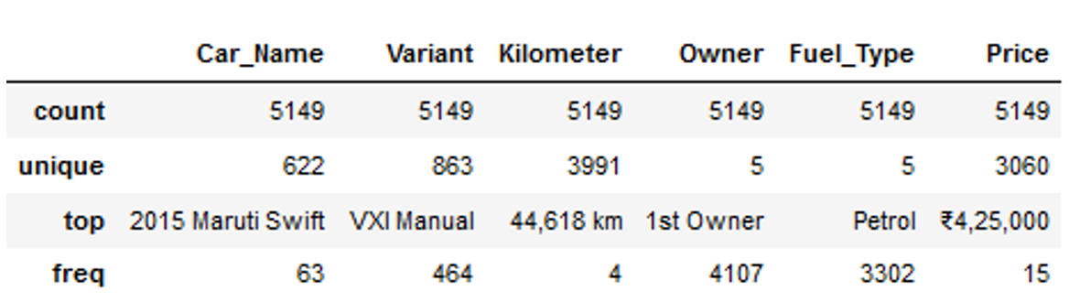
BASIC STATISTICAL MEASURES
Used basic statistical measures which provided below results

Slide 6
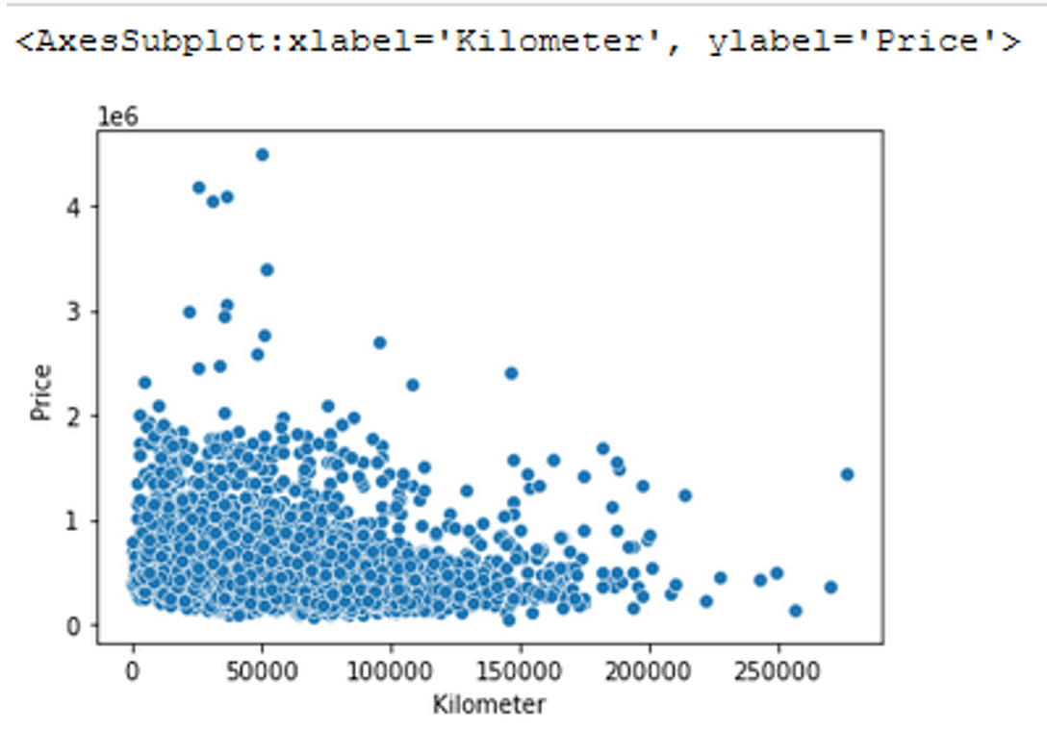
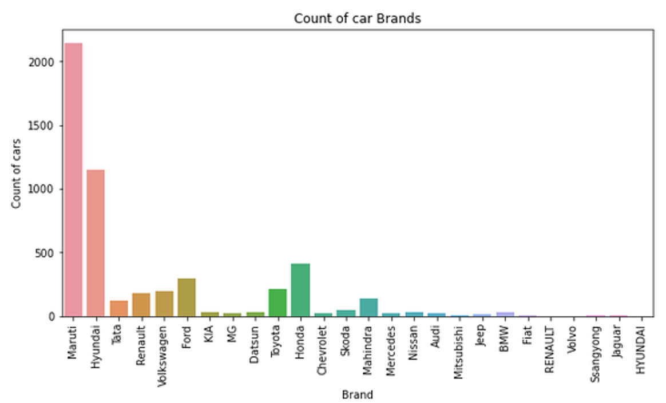
DATA VISUALIZATION
Scatter plots are used to observe relationship between variables and uses dots to represent the relationship between them.
The Matplotlib module has a method for drawing scatter plots, it needs two arrays of the same length, one for the values of the x-axis, and one for the values of the y-axis.
The scatter plot gave me a better intuition of how my variables were distributed.

Slide 7
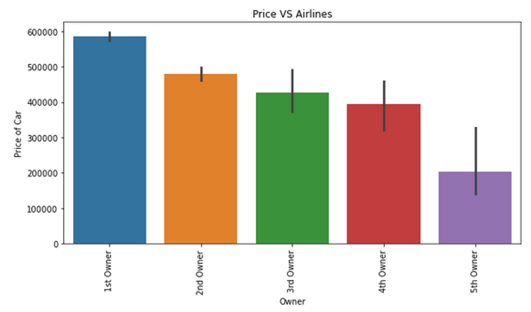
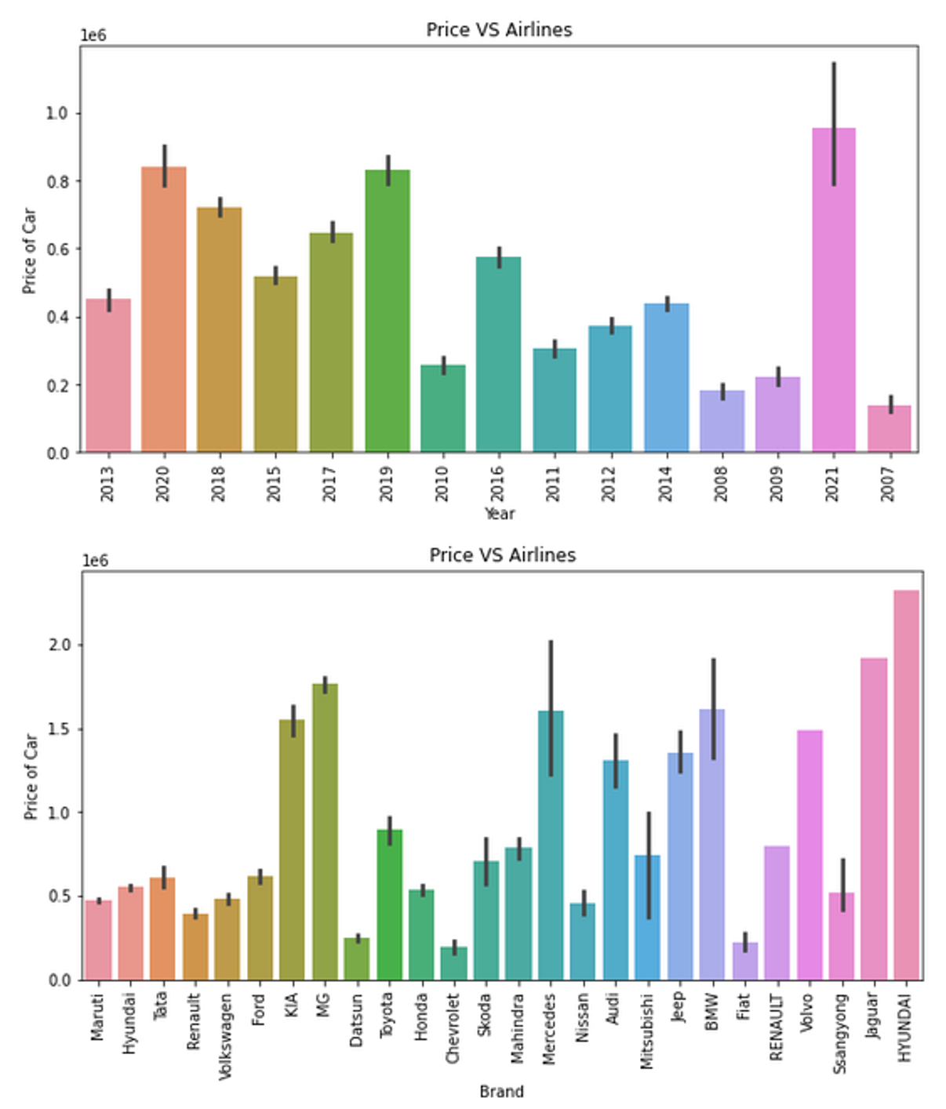
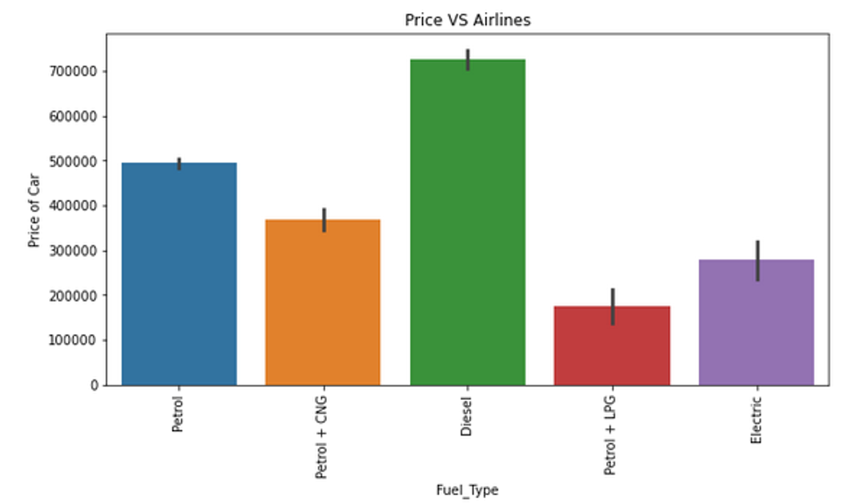
DATA VISUALIZATION

Slide 8
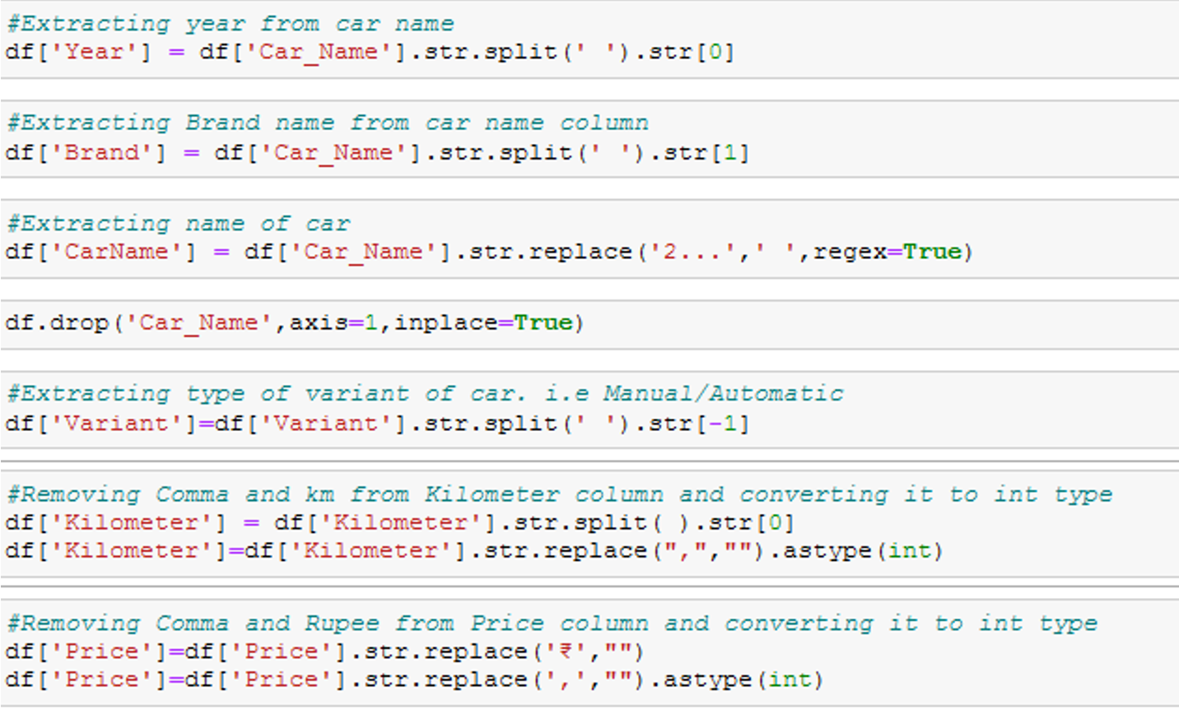
FEATURE ENGG. & SELECTION
Create Aggregated Features | Dealing with heavily Skewed features | Scaling/Normalizing numeric variables | Encodings for Categorical Variables

Slide 9
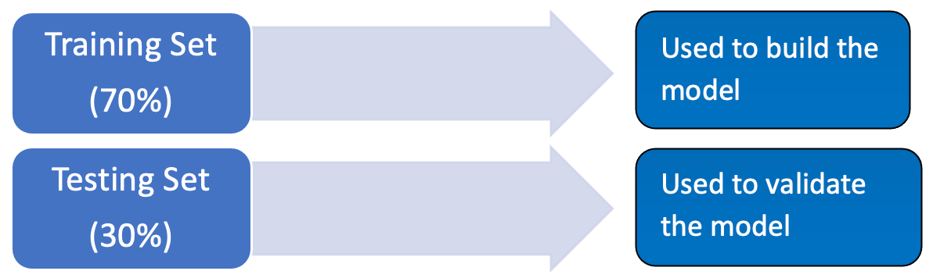
MACHINE LEARNING: SAMPLING
TRAINING SET : train the learning algorithm TEST SET : validate model and make optimization
As the model is built from the training set, we can’t check it on the same set because the result would be overly optimistic.
The test set is used only to see how well the learning algorithm is generalized, meaning how it performs with unknown data

Slide 10
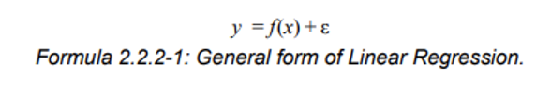
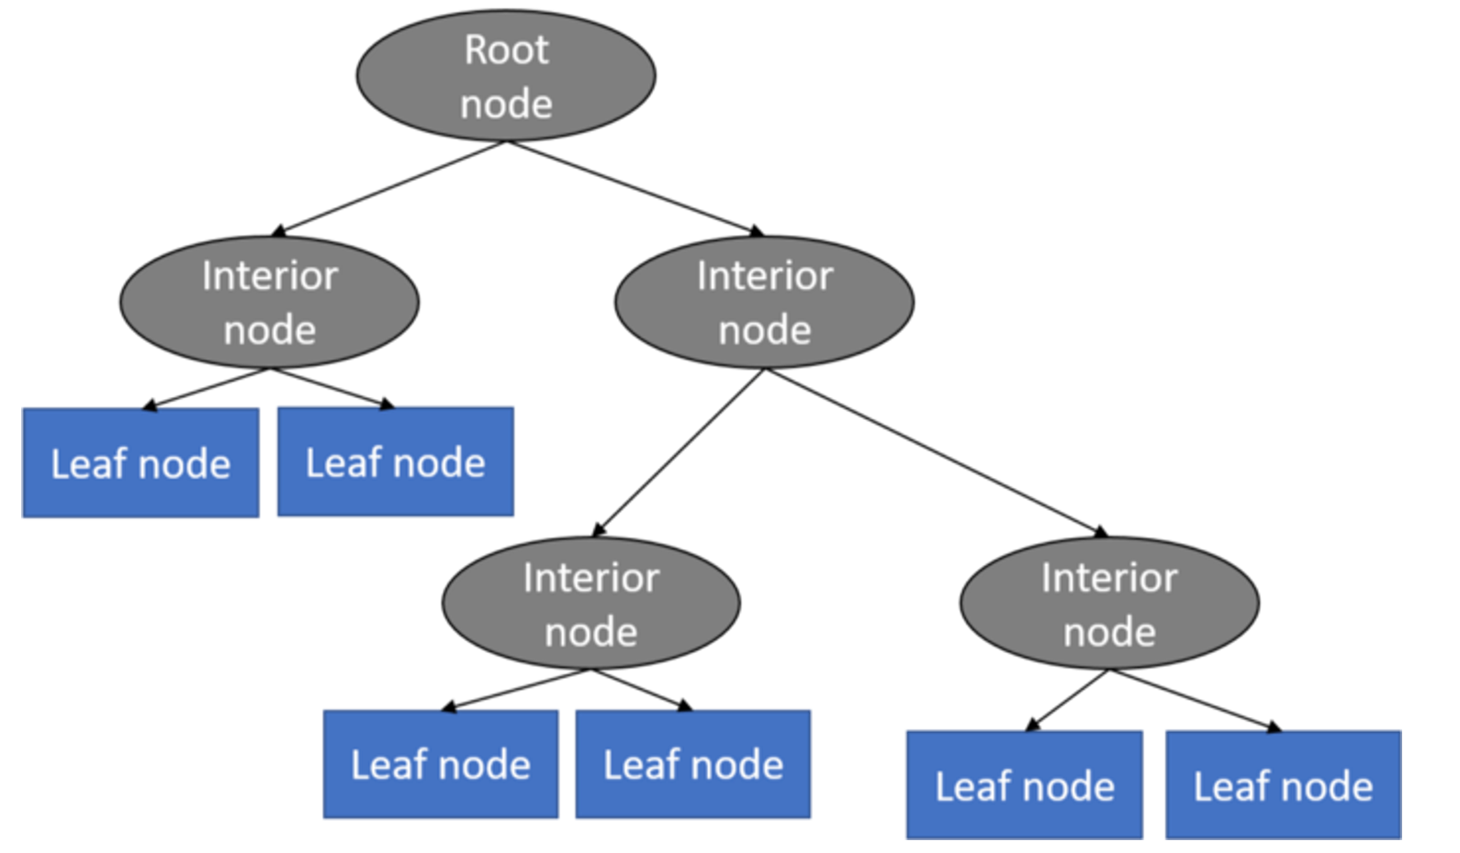
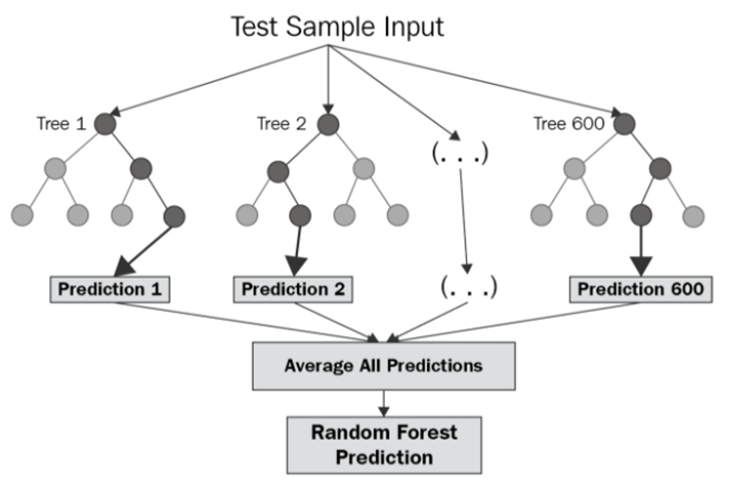
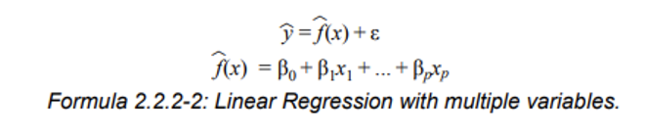
LEARNING ALGORITHM
1. Linear Regression
2. Decision Tree Regression
3. Random Forest Regression
4. K-Nearest Neighbour Regression
Approximates the association between independent variable & continuous outcome by averaging observations from the same neighbourhood.
Select size to minimize the mean square error

Slide 11
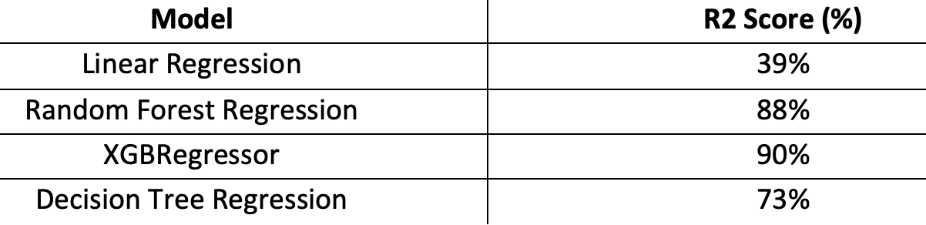
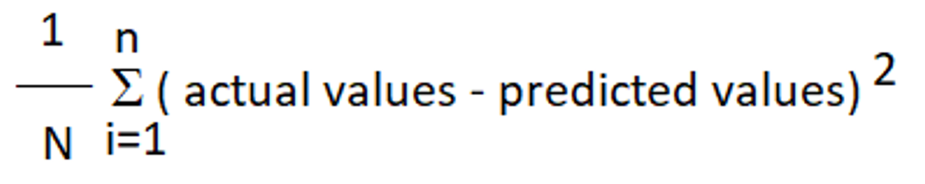
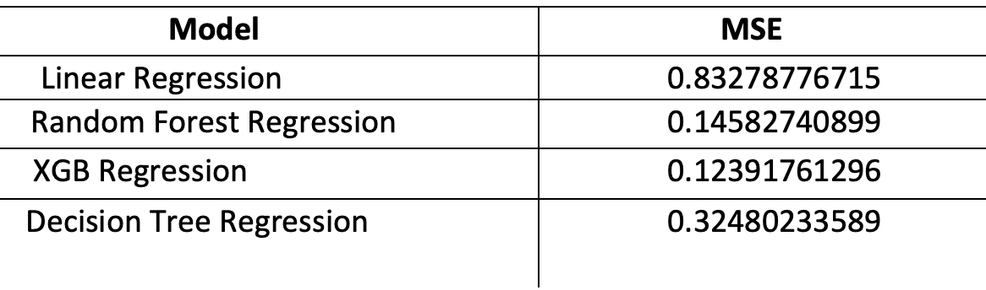
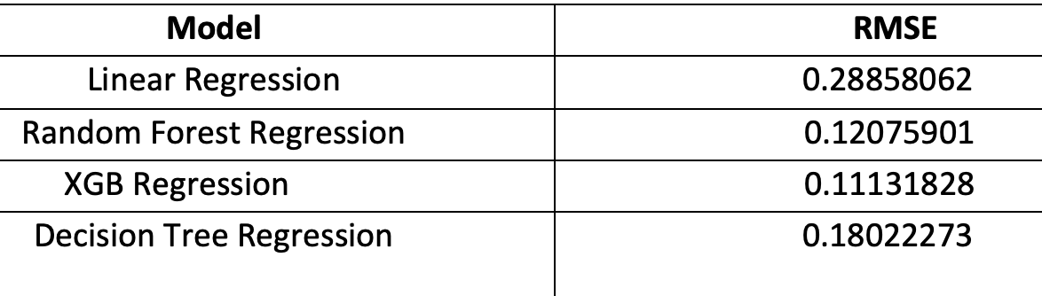
RESULTS
1. R2 Score
2. Mean Square Error (MSE)
3. Root Mean Square Error (RMSE)

Slide 12
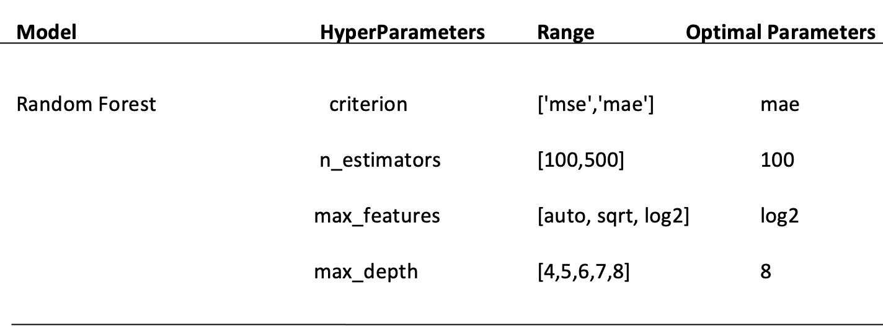
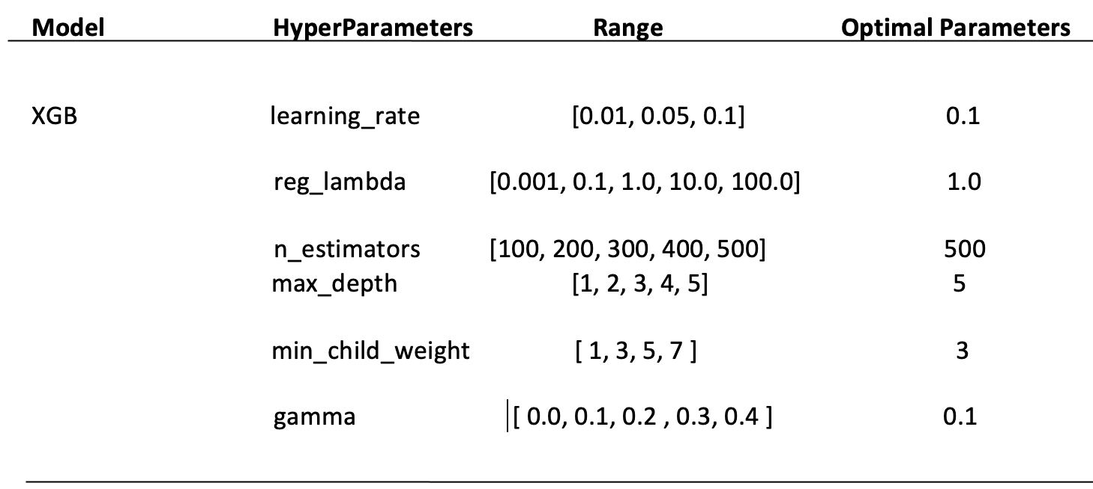
HYPER-PARAMETER TUNING
1. Random Forest
The r2 score we got after hyperparameter tuning for XGB regressor is 90% which is less than the default parameter model. So, we choose the XGB regressor with the default value as the best model for prediction.
2. Decision Tree

Slide 13
CONCLUSION
Majority of the people in India trusts Maruti, Hyundai and Honda. Very less people are buying cars from KIA, MG, Audi, Jaguar, Mercedes and more expensive cars
It is evident that price of cars decrease with increase in the number of owners..
Price of diesel car as compared to petrol and electric cars
As the car gets old, its sale price tends to decrease.
High end cars have more resale values. It is quite obvious as there cost price is also high.
As the number of kilometers covered by car increase, its price decreases.

